Slide 1

Agent Activity Chart
9/2/2022 5:22 AM
Print User : automation
Page 1 of 3

Slide 2
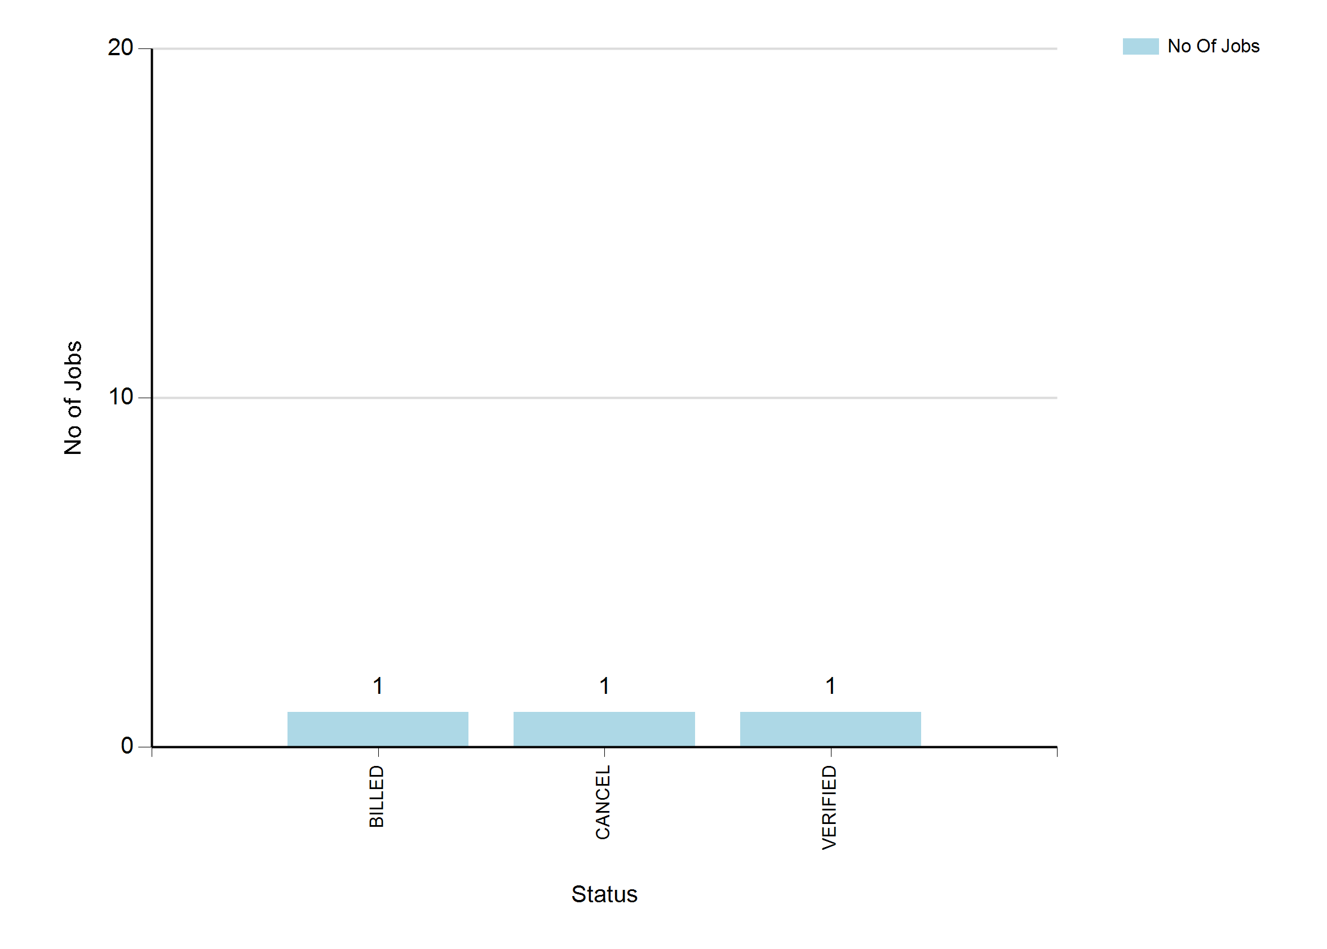
9/2/2022 5:22 AM
Print User : automation
Page 2 of 3

Slide 3
9/2/2022 5:22 AM
Print User : automation
Page 3 of 3

